Slide 1
Notes:
Introduction of yourself and the session.
My name is….I work for….today I am also here representing the Personal Finance Society. This is the membership organisation for people who work within this profession.
Today you are going to ‘Discover fortunes’ and take on the role of a financial planner/advisor. Does anyone know what a financial planner does?
.
.
.
Allow students to reply (do not wait for too long) and provide an example of what a financial planner does and how might go to one. Feel free to use your own experience.

Slide 2
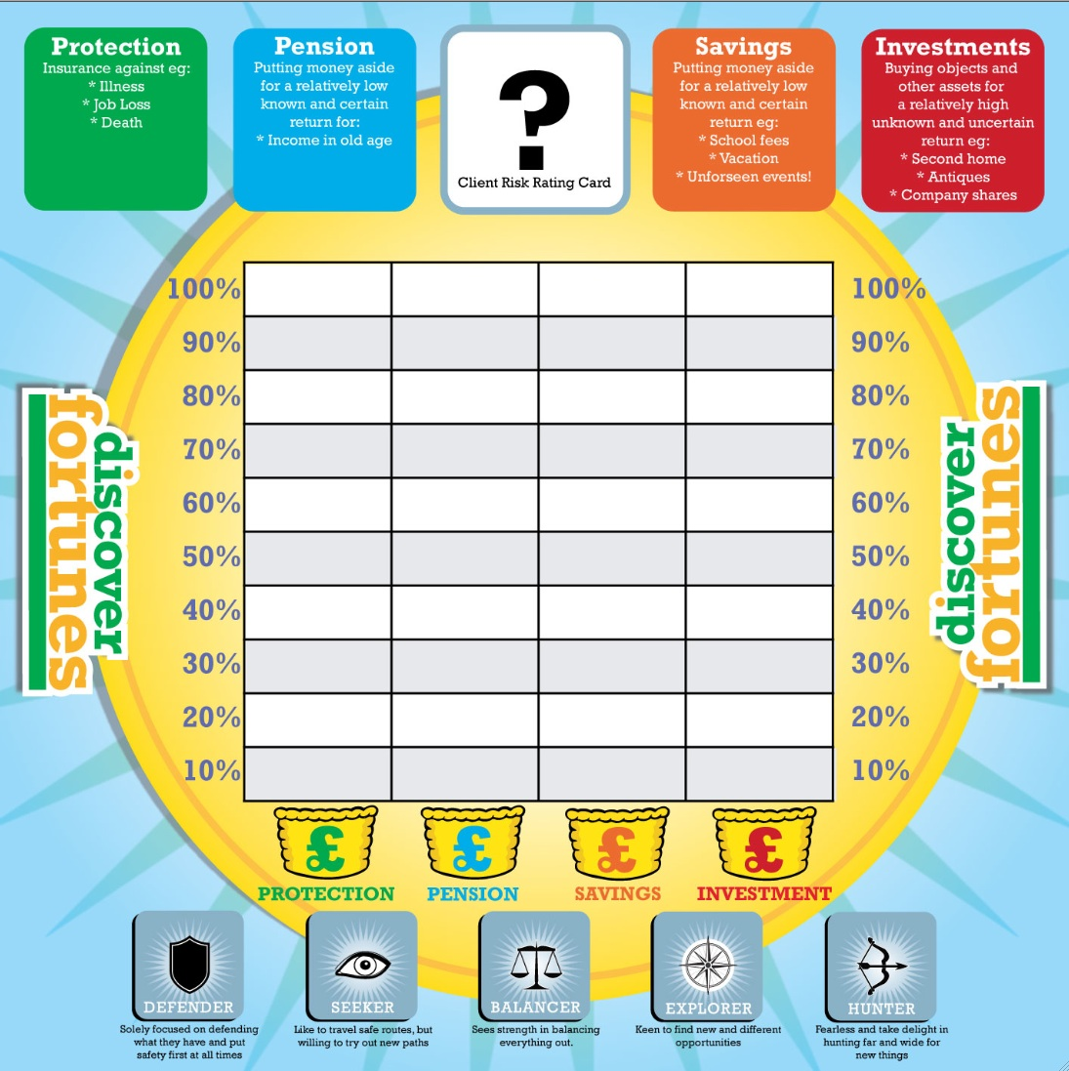
Objective:
In playing the game we hope that you…
understand the importance of the role of financial planning in everyone’s lives
realise some of the opportunities for you in the world of financial planning
practise your people skills of talking, listening and persuasion
practise your problem solving skills to analyse different information and make crucial planning decisions.
Notes:
Just like any lesson, there are a set of learning objectives for students taking part in a discover fortunes session.
There are 4 main objectives today which are…
VOLUNTEER TIP: Another interesting point is that this type of game can often be used in assessment centre days. Students generally do not know what these are. Assessment days are when you have got passed your initial application for a job and you find yourself in a room with another 10-20 other people going for the same role. By playing such a game, employers can assess your soft skills. These include: communication, teamwork, listening, persuasion, decision making, leadership etc. From this, a decision can be taken as to whether or not you continue for interview with the company.

Slide 3
The Finance Sector
Did you know the UK finance sector…
contributes around 7% of the UK’s gross domestic product?
employs over 1 million people with a further million working in related jobs?
offers a huge range of job opportunities to young people looking to make a great start in life?
apprenticeship routes into the profession available.
has established financial advisers earning up to c£50k
has top financial planners/advisers earning in excess of £150k
Notes:
Introduction of the UK finance sector:
7% contribution £124.2 billion
1 million people in jobs directly relating to financial services and the further 1 million in support roles (marketing, accounts, management, it, legal, sales, admin etc..)
Huge range of job opportunities to school leavers looking at an alternative to university. Apprenticeship openings (link towards the end of powerpoint).
Estimated salaries. If students are motivated by money, could sector to work in.

Slide 4
Financial Planning Introduction
Should the video on this slide not work, please follow this link to our YouTube channel here.
Notes:
Play the video on financial planning.
Video is already integrated through youtube and should play providing there is a good internet connection!
URL Link: https://www.youtube.com/watch?v=NuMAdP2X_cM

Slide 5
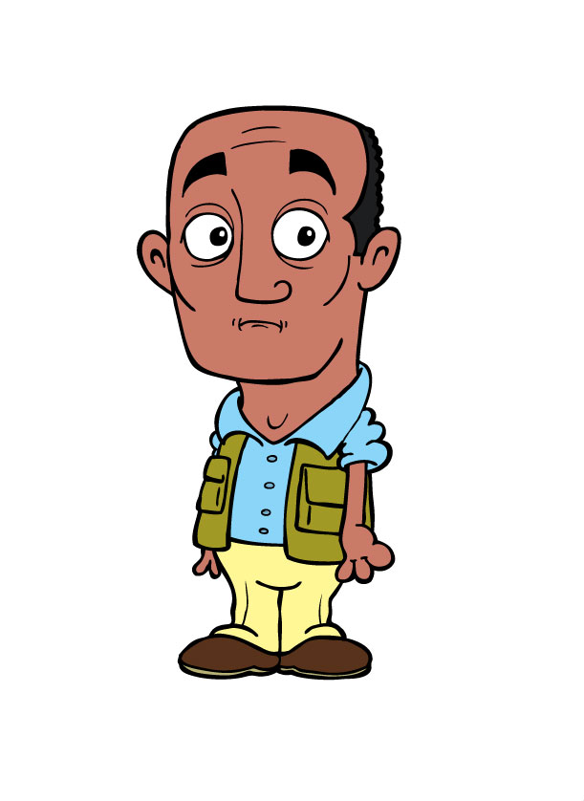
Discover Fortunes!
How to play the game…
In your teams you will compete to correctly diagnose the financial options and plan the financial portfolios of five different clients
The people you will meet are all based on real people with real money to manage
The winning team will be the one that scores the most points by the end of the game.
Notes:
Introduction as to how to play the game…
STUDENT TIP: Remember when we go through the game that in your teams, you are taking the roles of financial advisers! In the real world, you would be fully qualified and be able to take important decisions so, there is an element of listening to what your clients want and advising them on what is suitable for them.

Slide 6
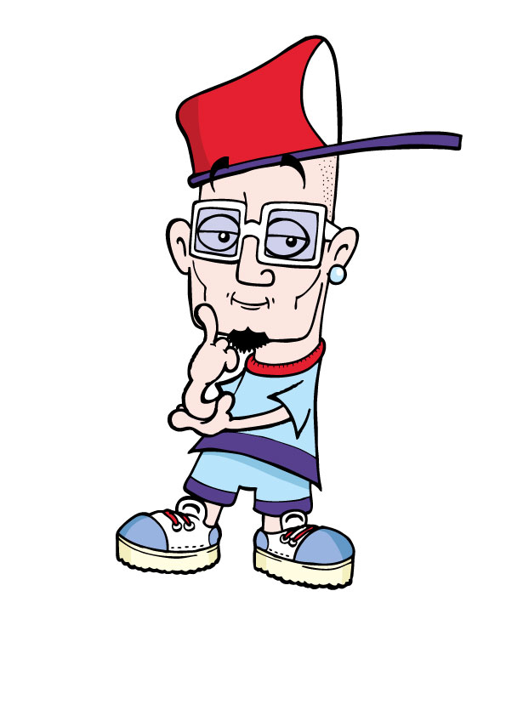
Planning the Portfolio
Dividing money across four different baskets
Step 1 – decide your client’s attitude to risk
Step 2 – spread your client’s money between the four financial baskets
100%
90%
80%
70%
60%
50%
40%
30%
20%
10%
Protection
Pension
Savings
Investments
Carter’s risk profile was a Balancer, so our financial planner balanced his portfolio in this way…
Notes:
Planning the portfolio.
Step 1 – decided your clients attitude to risk. There are 5 different risk profiles to choose from.
Step 2 – spread your client’s money between the four financial baskets!
STUDENT TIP: Make sure that when you do this, they add up to 100% otherwise you have made a mistake
Show Carter’s risk profile and how his money was spread as he was a ‘balance’
STUDENT TIP: If your client is more of a defender/seeker, you are more likely to have more money spread over protection and pension than savings or investments. Equally, if you decide your client is more of an explorer or hunter, the right hand side of the board would have more money in it than the left hand side.

Slide 7
How the Scoring Works
Each client has different needs and there will be five different solutions for their four baskets…
1
1
1
1
If you’ve correctly identified your client’s risk type you score - 5 points
If your coin is one square above or one square below the correct % square you score - 1 point
If your coin is spot on in the correct % square you score - 5 points
Maximum points each round - 25 points
N.B. On rare occasions a basket should be left empty. You score – 0 points if you place a coin in such a basket but score - 5 points if you correctly leave it empty!
JOKER CARD – can only be used once to double your points!
100%
90%
80%
70%
60%
50%
40%
1
1
✓
✓
30%
1
5
1
5
✓
✓
20%
5
1
5
1
10%
1
1
Protection
Pension
Savings
Investments
Notes:
How the scoring works.
Pretty self explanatory…
TIP: On rare occasions, a basket might be left empty. For example, a retired couple already taking out their pension would not be expected to be continuing paying into a pension.

Slide 8
Sherene Darby
Should the video on this slide not work, please follow this link to our YouTube channel here.
Notes:
First example..
Show Sherene Derby and allow 7-10 minutes of discussion and completion
URL link: https://www.youtube.com/watch?v=6ozQNKDSldM

Slide 9
Sherene’s Portfolio
100%
90%
80%
70%
60%
50%
40%
30%
20%
10%
Protection
Pension
Savings
Investments
Notes:
Introduce answer
VOLUNTEER TIP: Go around the room and ask students to feedback on which risk type they suggest for each client.
Reveal answers and provide some explanation (see notes)
VOLUNTEER TIP: You can either make sure students are recording their scores OR take note of the scores yourself. Generally, emphasis is placed on students to keep track with scores collected at the end and winners revealed.

Slide 10
Aruna Sen
Should the video on this slide not work, please follow this link to our YouTube channel
here.
Notes:
Repeat process from Sherene..
URL Link: https://www.youtube.com/watch?v=cfdVfTCKgcM

Slide 11
Aruna’s Portfolio
100%
90%
80%
70%
60%
50%
40%
30%
20%
10%
Protection
Pension
Savings
Investments
Notes:
Introduce answer
VOLUNTEER TIP: Aruna was a risky character from the video. She liked to play poker at university and shows little fear for taking risks.
Reveal answers and provide some explanation (see notes)

Slide 12
Melvin Maverique
Should the video on this slide not work, please follow this link to our YouTube channel
here.
Notes:
Show Melvin video
N.B. Melvin has a quiet voice so, volume must be turned up for this.
URL Link: https://www.youtube.com/watch?v=bkOauR2uZCA

Slide 13
Melvin’s Portfolio
100%
90%
80%
70%
60%
50%
40%
30%
20%
10%
Protection
Pension
Savings
Investments
Notes:
VOLUNTEER TIP: His main priority is his family which lends itself to being a defender
Reveal answers and provide some explanation (see notes)

Slide 14
Elizabeth Lately
Should the video on this slide not work, please follow this link to our YouTube channel
here.
Notes:
Show video and allow 7-10 minutes discussion time.
URL link: https://www.youtube.com/watch?v=obW5tQPVg6o

Slide 15
Elizabeth’s Portfolio
100%
90%
80%
70%
60%
50%
40%
30%
20%
10%
Protection
Pension
Savings
Investments

Slide 16
Lao & Jules Chan
Should the video on this slide not work, please follow this link to our YouTube channel
here.
Notes:
Final animations
STUDENT TIP: Remember that not all baskets need to be filled. Make sure you debate and justify each of the financial options for this last one
URL Link: https://www.youtube.com/watch?v=LmfBH1xKHMQ

Slide 17
Lao and Jules’ Portfolio
100%
90%
80%
70%
60%
50%
40%
30%
20%
10%
Protection
Pension
Savings
Investments
Notes:
Reveal answers.
High risk takers.
“You win some, you lose some”
No need for protection or pension. Everyone needs accessible cash reserves to cover unforeseen expenses. They are open to opportunities for investment wherever they arise.

Slide 18
Outcomes
In playing the game we hope that you…
have practised your people skills of listening and persuasion
have practised your problem solving skills to analyse different information and make crucial planning decisions
understand more about the importance of the role of financial planning in everyone’s lives
realise some of the opportunities for you in the world of financial planning.
Notes:
Before revealing scores, talk through learning outcomes.

Slide 19
Next steps - Keep In Touch - CII Discover Membership
Keep In Touch…
ciistepforward.co.uk
Membership
https://www.ciistepforward.co.uk/member/register
Benefits
Free membership
Access to sector reports, research and information
Looks very good on your CV if you are applying for an apprenticeship in the profession
Notes:
Students are encouraged to find out more about personal finance should they wish especially if they are interested in the careers side of things as they can sign up and become student discover members. Please leave this slide up at the end for those interested in this to sign up online independently. Students must be 16+ to apply.

Slide 20
Thanks for playing…
A learning game created by:
Notes:
Reveal winners and take any questions…

